Slide 1


GRAPHICAL PROCESSING UNIT
Kanisha Stuti Meet
253 269 299

Slide 2


CONCEPTS
Graphical Processing Unit
Components
Subcircuit
Graphs

Slide 3
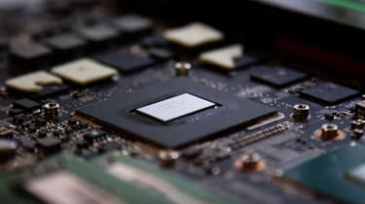
What is GPU?
Graphics processing unit, a specialized processor originally designed to accelerate graphics rendering.
GPUs can process many pieces of data simultaneously, making them useful for machine learning, video editing, and gaming applications

Slide 4
COMPONENTS
MUX (4 X 1)
COUNTERS
DEMUX (1 X 16)
DECODER ( 1 X 16)
ROM (DATA BIT -16)
SCREEN REGISTER

Slide 5
SUBCIRCUIT
SCREEN REGISTER
Register(16 Bits)
Or Gate

Slide 6
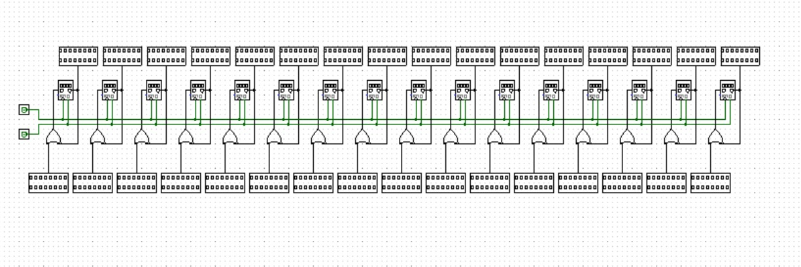

Slide 7
GRAPHS
Y = X
Y = 2X
Y = 3X
Y = 4X

Slide 8
THANKYOU

